Slide 1

Chhattisgarh Swami Vivekanand Technical University University Teaching Department Department of Computer Science and Engineering
Presented By
Dolly Sahu
300012821034
CB4685
Major Project Presentation
On
ContentCraft-Hub: Personalized CMS Platform
Rajkamal Banjare
300012821023
CB4685
Dr. Rohit Miri
Associate Professor

Slide 2
Content
Intuitive & User-Friendly CMS: A seamless platform for small businesses and freelancers to manage websites, blogs, and portfolios effortlessly.
Feature-Rich Customization: Includes a drag-and-drop builder, rich text editor, customizable templates, and built-in SEO tools for optimized content management.
Modern & Scalable Technology: Built with HTML, CSS, Bootstrap, JavaScript, Node.js, and MongoDB/PostgreSQL, hosted on Netlify and GitHub Pages with cloud-integrated media, analytics, multilingual support, and e-commerce capabilities.

Slide 3
Research Objective
Analyze and develop an intuitive CMS for seamless website, blog, and portfolio management.
Implement a feature-rich, user-friendly interface with a drag-and-drop builder and customization tools.
Optimize performance and scalability using modern web technologies like HTML, CSS, Bootstrap, JavaScript, Node.js, and MongoDB/PostgreSQL.
Ensure seamless deployment and hosting on platforms like Netlify and GitHub Pages.
Enhance accessibility, multilingual support, and SEO capabilities for a broader user reach.

Slide 4
Problem Statement
Small businesses and freelancers struggle with complex and costly website management solutions.
Existing CMS platforms often lack flexibility, personalization, and ease of use.
Limited technical expertise makes it challenging for users to build and maintain websites efficiently.
Many CMS solutions require extensive thirdparty integrations, increasing setup complexity.
Ensuring scalability, SEO optimization, and multilingual support remains a challenge for growing businesses.

Slide 5
Literature Survey
CMS/Platform | Key Features | Limitations
Product Hunt | Platform for discovering and promoting tech products; community-driven feedback. | Lacks website-building capabilities; not a full CMS.
Dev.to | Blogging platform with content publishing and community engagement. | Limited customization; lacks advanced CMS features like drag-and-drop builders.
WordPress | Powerful open-source CMS with extensive plugins, themes, and SEO tools. | Can be complex for beginners; requires third-party plugins for advanced features.
Ghost | Minimalist CMS focused on blogging and content-driven websites; fast and lightweight. | Limited built-in customization; lacks a drag-and-drop builder.
Wix | Website builder with drag-and-drop functionality, templates, and hosting. | Less flexible than open-source CMS; limited scalability for advanced development.
Medium | Clean and simple blogging platform with a built-in audience. | No website-building capabilities; content is hosted on Medium’s platform, reducing ownership control.

Slide 6
Research Methodology
1. Problem Identification & Literature Review – Define the issue and analyze existing solutions.
2. Requirement Analysis & System Design – Gather requirements and select the appropriate technologies.
3. Development & Implementation – Build and integrate the core system features.
4. Testing & Deployment – Optimize, test, and launch the system.
5. Evaluation & Future Enhancements – Analyze performance and plan improvements.

Slide 7
Expected Outcome/Outcome
A user friendly and efficient CMS with seamless integration of blogging features.
Enhanced content management capabilities with better customization and flexibility.
Improved user engagement through interactive and visually appealing design.
Seamless integration with third-party tools and plugins for extended functionality.
Optimized system performance ensuring faster content delivery and response times.
Future scalability and adaptability for evolving user needs and technological advancements.

Slide 8
Result/Discussions
The logo and title for the website have been finalized.
The GitHub repository has been created and structured appropriately.
The color palette has been carefully selected to align with the design vision.
The website resources and overall design are currently under development.
Core functionalities have been implemented and tested for usability.
Feedback and refinements are being incorporated to enhance user experience.
Final Output: A fully functional, well-structured, and visually appealing website that meets the project objectives.

Slide 9
Scope of Project
Develop a user-friendly and responsive website interface.
Integrate interactive elements to enhance user engagement.
Ensure compatibility across different devices and browsers.
Optimize the website for performance and accessibility.
Implement a structured content management system for scalability.
Implement security measures to protect user data and website integrity.
Establish a version control system for collaborative development.
Plan for future updates and feature enhancements.

Slide 10

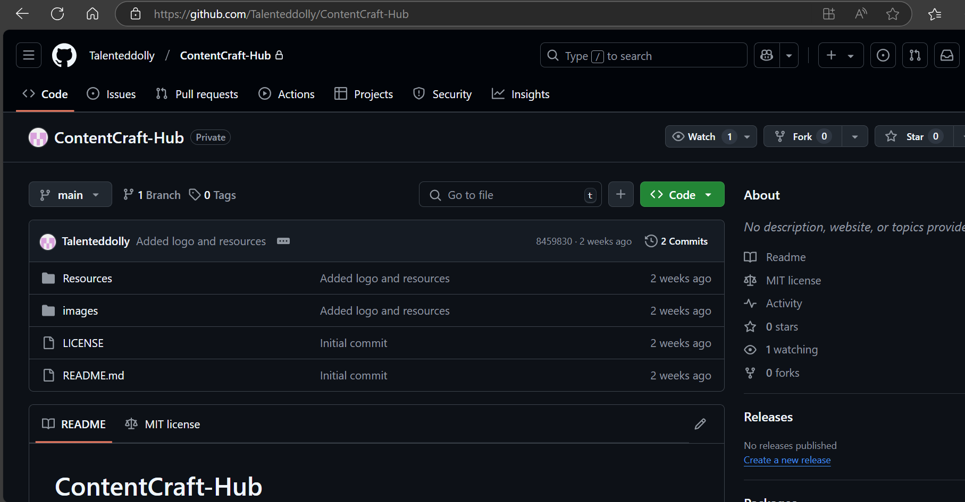
Progress So far
The logo and title for the website have been finalized.
The GitHub repository has been created and structured appropriately.
The color palette has been carefully selected to align with the design vision.
The website resources and overall design are currently under development.
Fig 1: Logo
Fig 2: GitHub Repository

Slide 11
References
Books:
Designing for the Web: Content, UX, and Accessibility – Jeffrey Zeldman
Websites:
https://dev.to
https://medium.com
https://wordpress.org
https://ghost.org
https://www.wix.com

Slide 12
Thank you

